Slide 1
TensorBoard
on MLP

Slide 2
How it works:
1. Use “with tf.variable_scope(“NAME”):
2. Define summary writer
- summary_writer = tf.train.SummaryWriter(“PATH”, graph=sess.graph)
3. Define scalars to summary
- tf.scalar_summary(‘cross_entropy’, cost)
- tf.scalar_summary(‘accuracy’, accr)
4. Merge summaries
- merged = tf.merge_all_summaries()
5. Session run merge
- summary = sess.run(merged, feed_dict: ~)
6. Add to summary writer
- summary_writer.add_summary(summary, index)

Slide 3
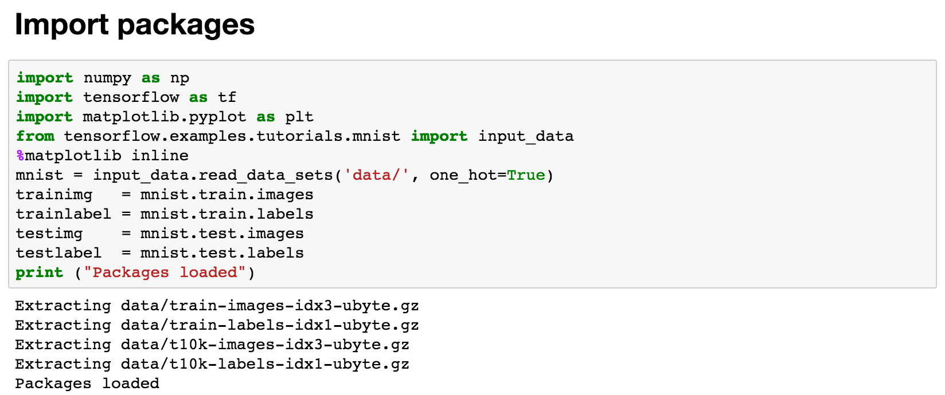
Multi layer perceptron

Slide 4
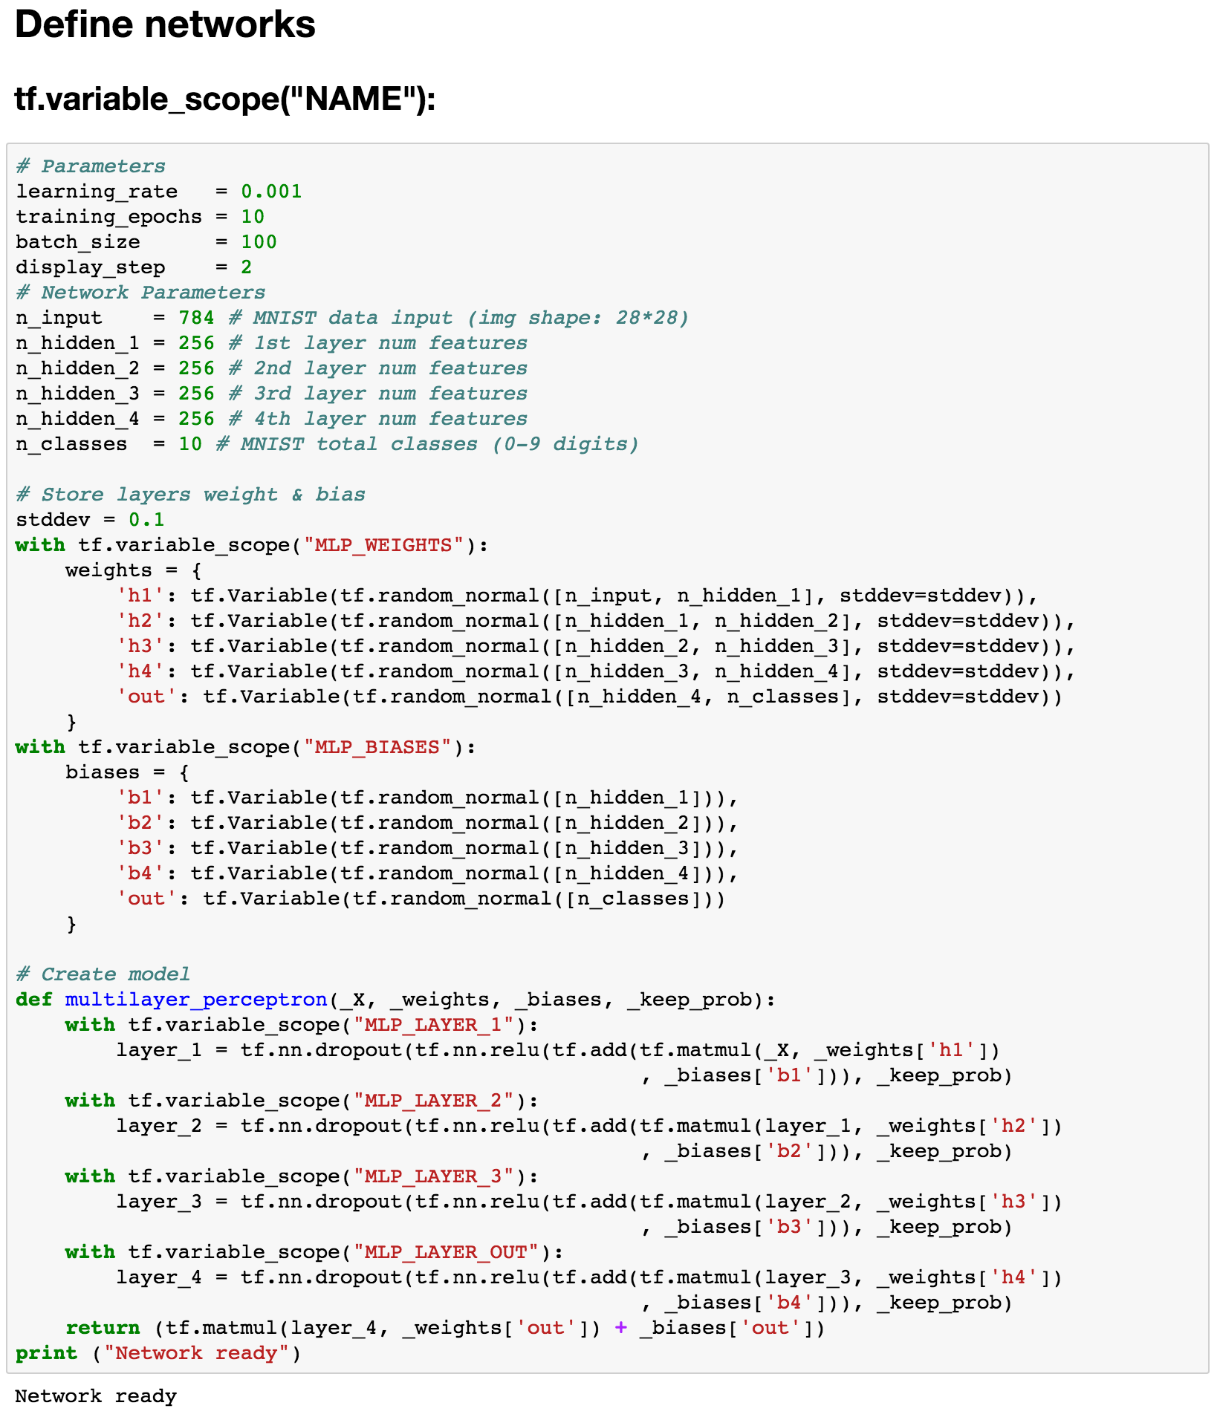

Slide 5
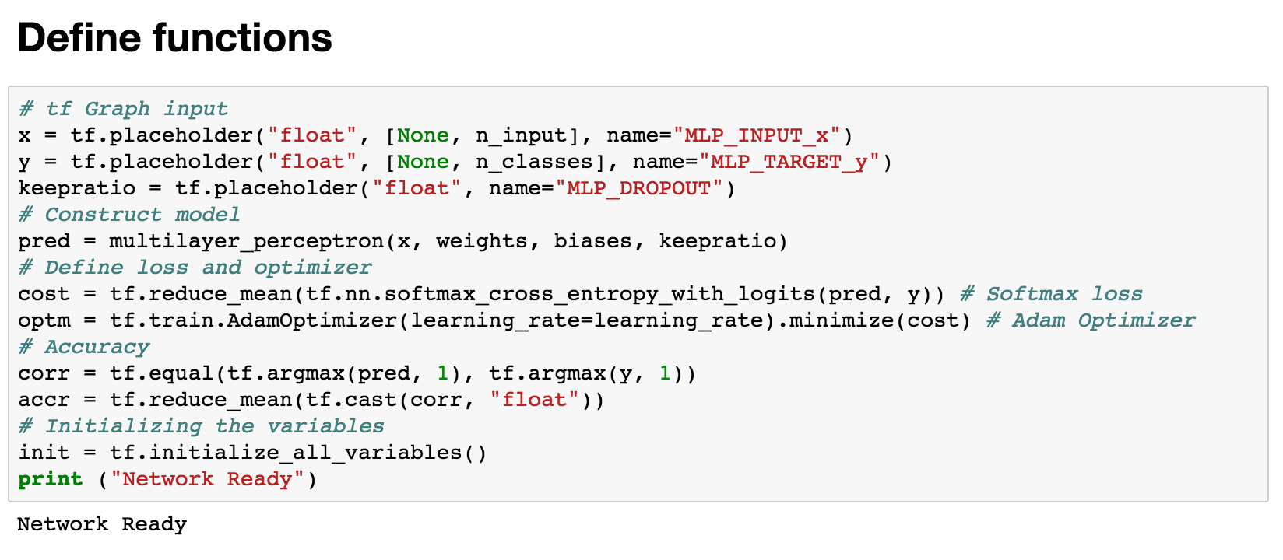
Define functions

Slide 6
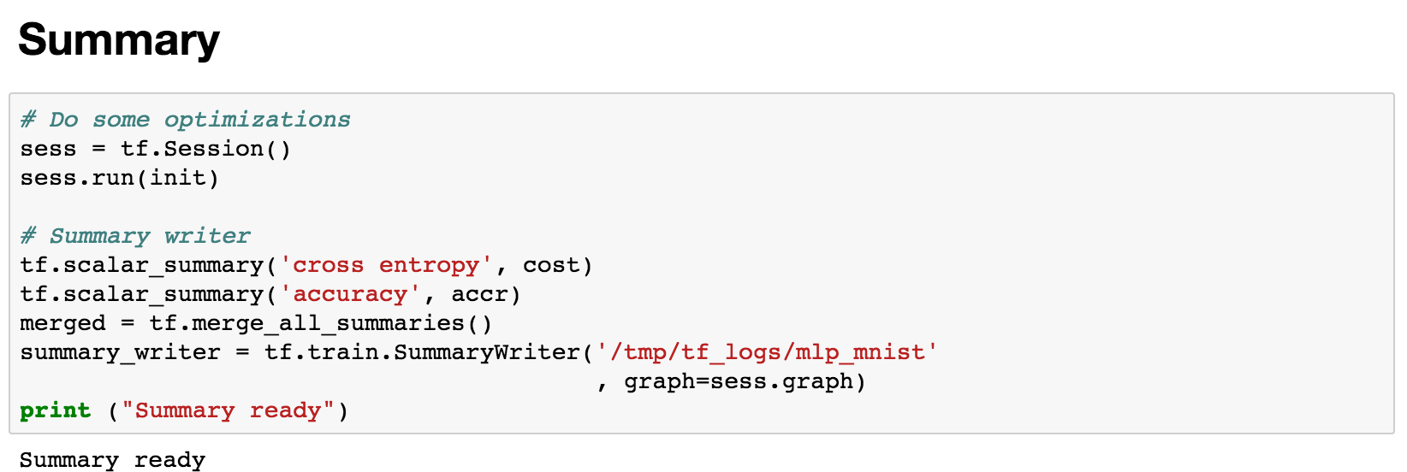
Define summary

Slide 7
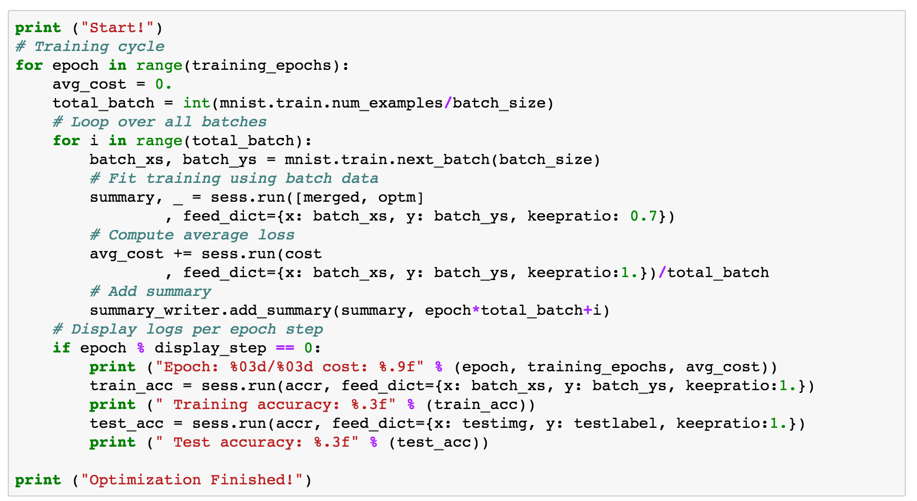
Run

Slide 8
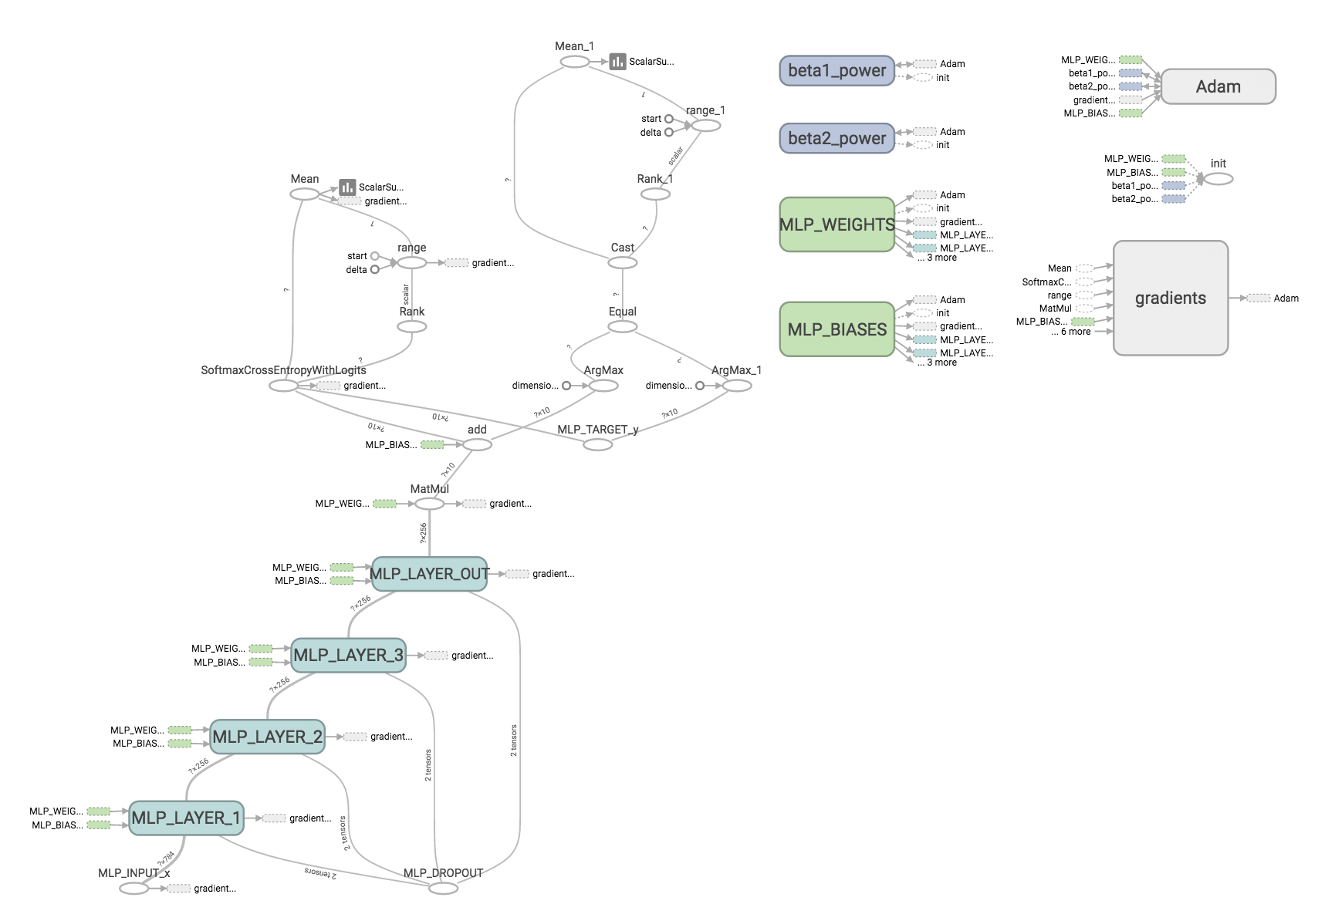

Slide 9
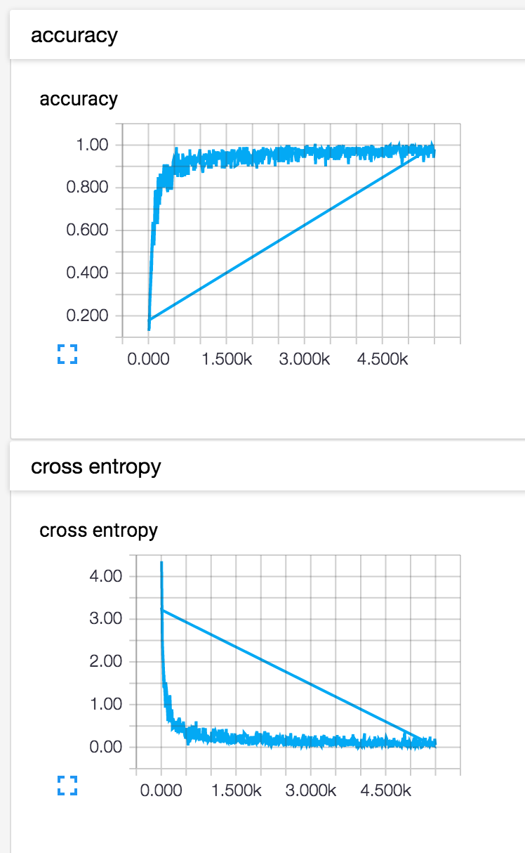
Events

Slide 10
TensorBoard
on CNN

Slide 11
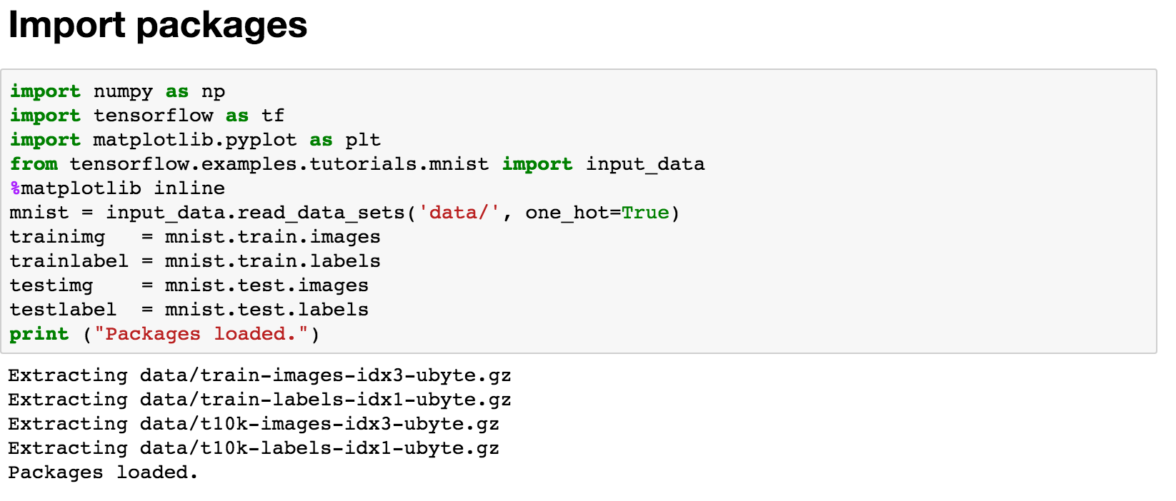

Slide 12
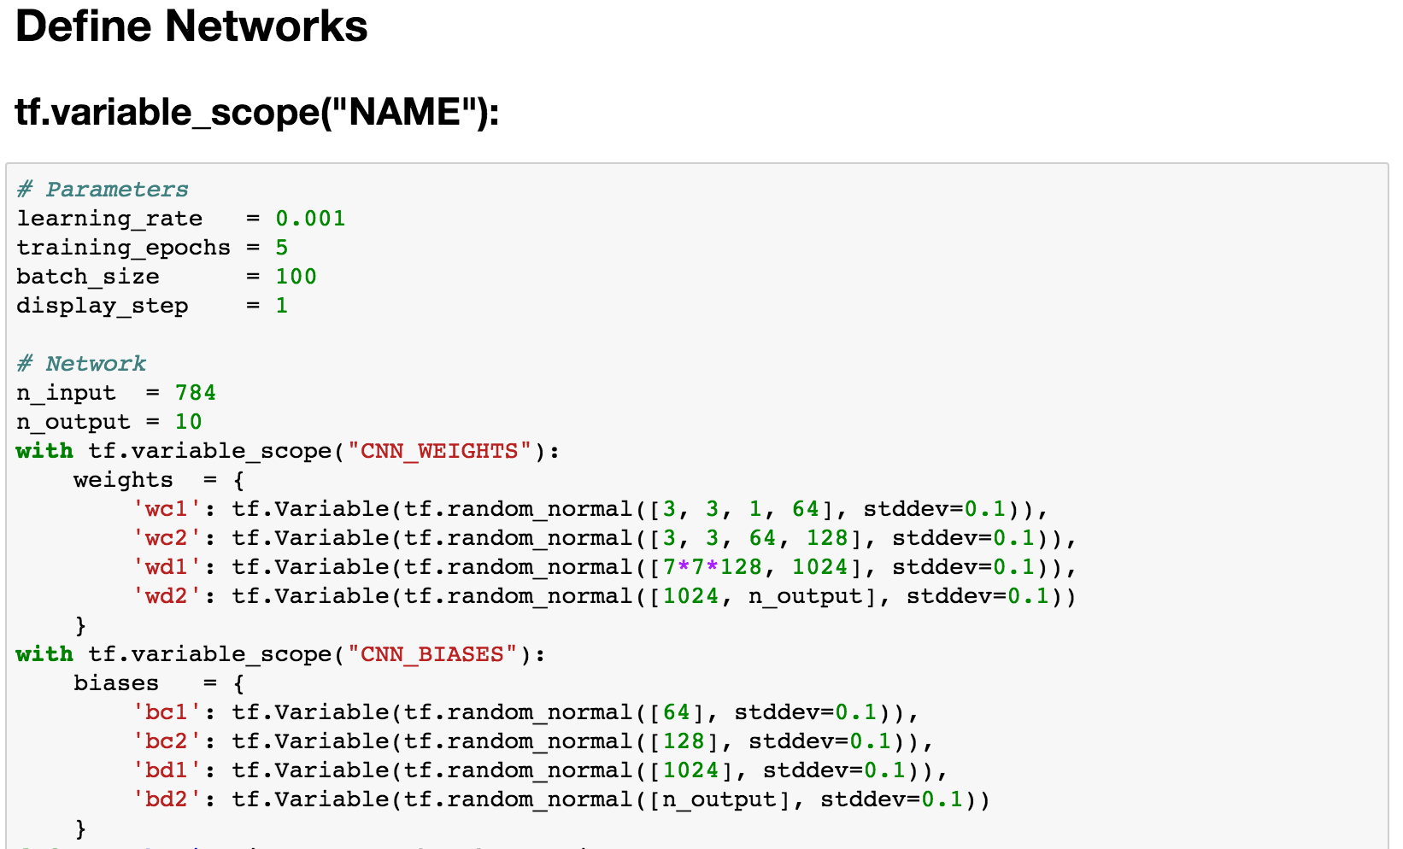

Slide 13
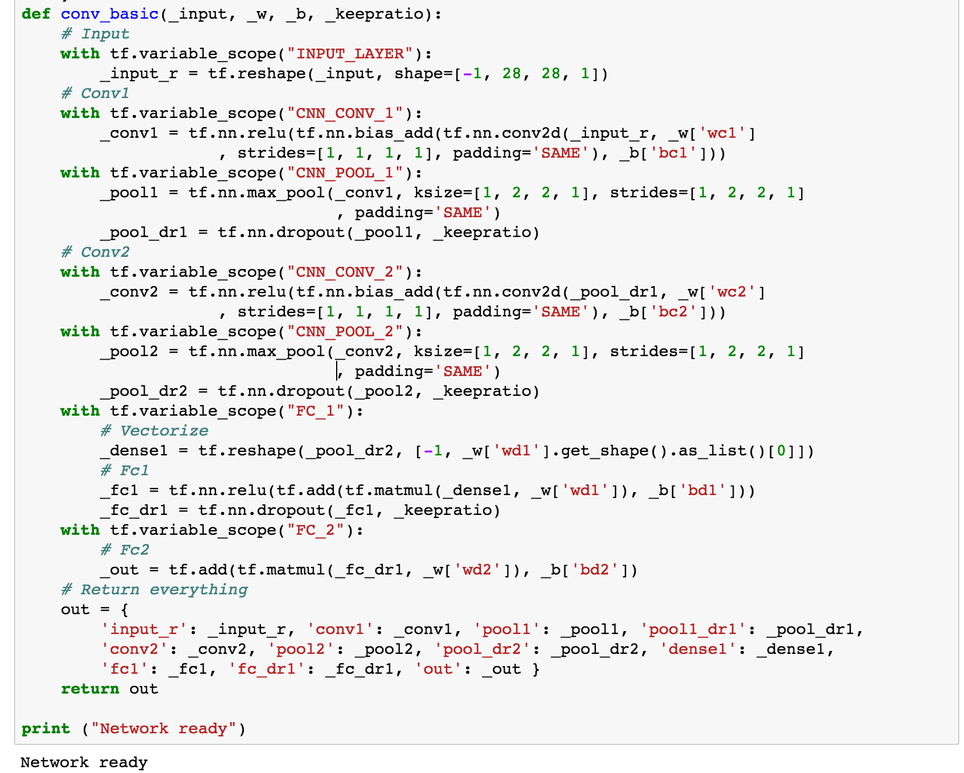

Slide 14
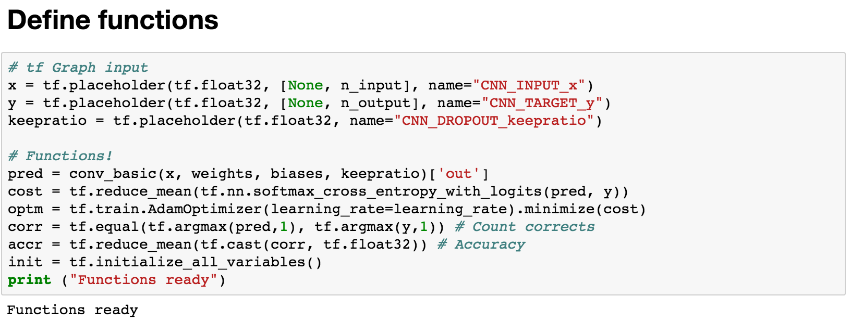

Slide 15
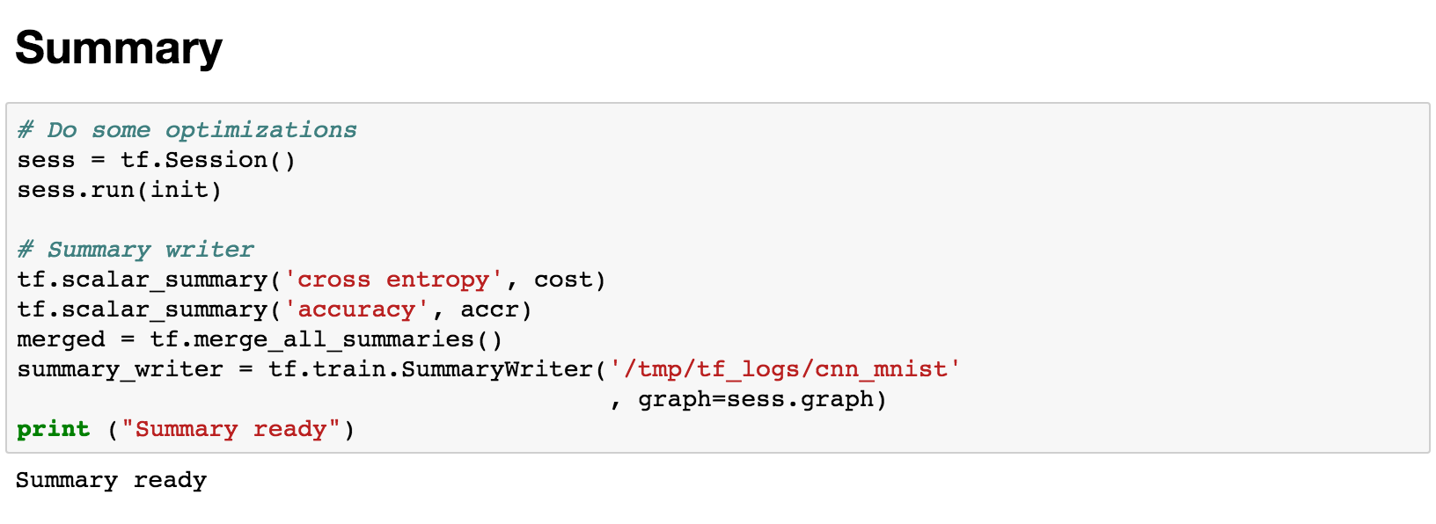

Slide 16
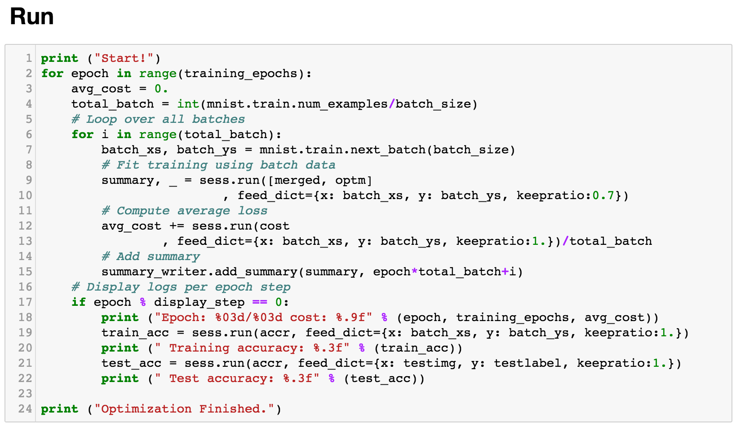

Slide 17
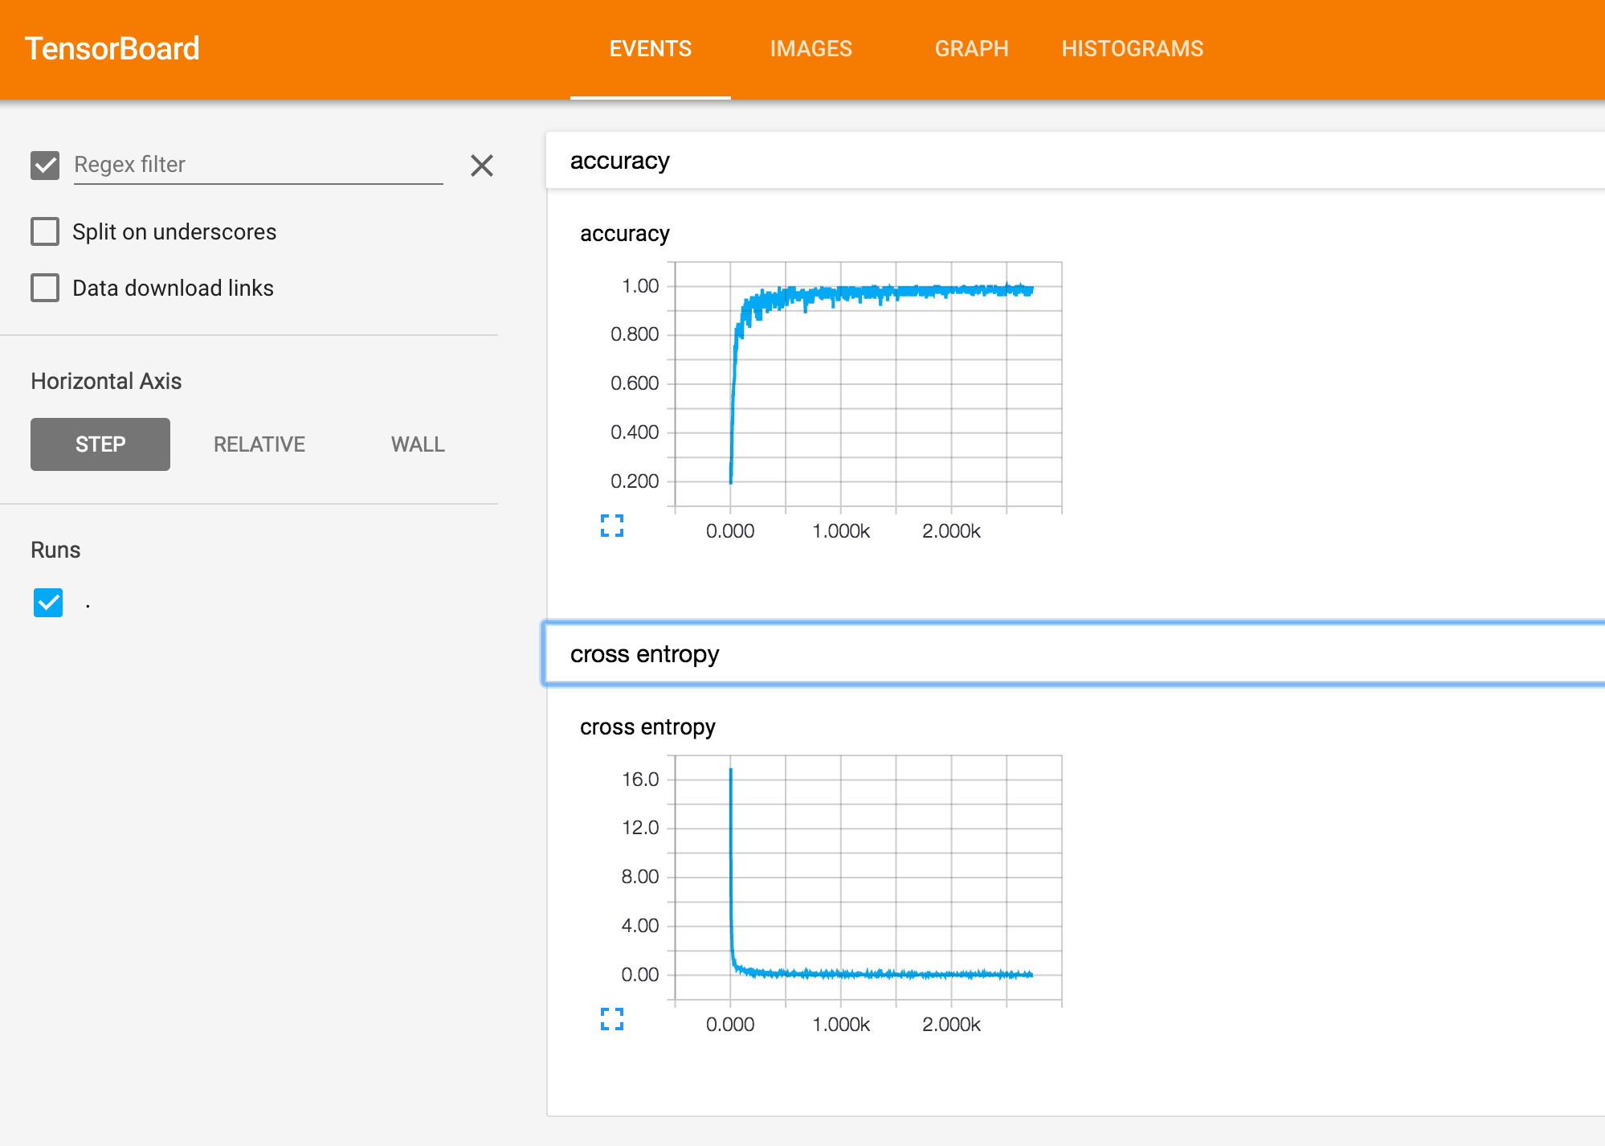

Slide 18
